Slide 1

Compiler Design
Divyaprabha K N
Assistant Professor,
Department of Computer Science & Engineering

Slide 2

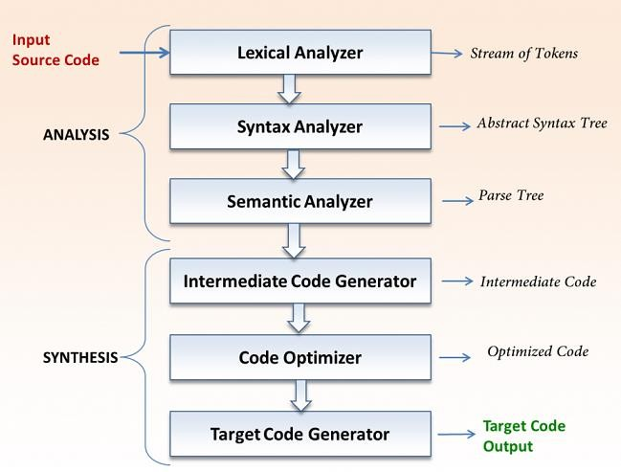
COMPILER DESIGN
The Structure of a Compiler
Phases of a Compiler
SYMBOL TABLE

Slide 3



COMPILER DESIGN
The Structure of a Compiler
Phases of a Compiler
Source Program
Lexeme (Sequence of Tokens)
Token
<token-name, attribute value>
token
name
aatttributtributee vvalue
Source Program
Lexeme | Tokens
a | <id, 1>
a = b + c * 60
<id, 1> <=> <id, 2> <+> <id, 3> <*> <60>

Slide 4

COMPILER DESIGN
The Structure of a Compiler (Phases of a Compiler)
a = b + c * 60
<id, 1> <=> <id, 2> <+> <id, 3> <*> <60>
=
id1
+
id2
*
id3
60

Slide 5
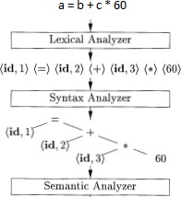
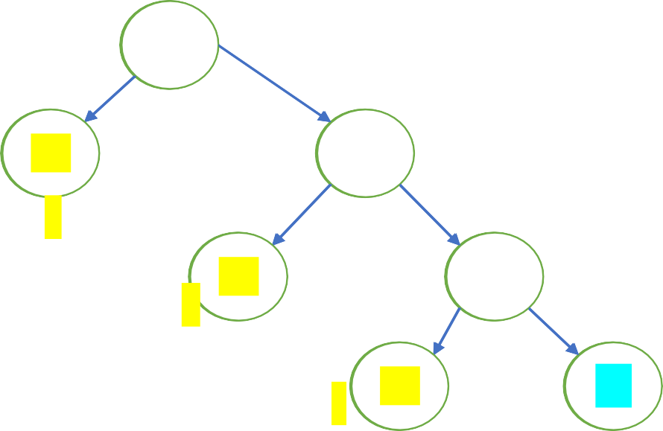
COMPILER DESIGN
The Structure of a Compiler (Phases of a Compiler)
=
id1
+
id1
a
id2
*
b
id2
=
id3
60
c
id3
60
id1
+
Type-checking
id2
*
id3
inttofloat
60

Slide 6

COMPILER DESIGN
The Structure of a Compiler (Phases of a Compiler)

Slide 7
COMPILER DESIGN
The Structure of a Compiler (Phases of a Compiler)
Three address code assignment instructions:
It can have max one operator towards right side
They must generate a temporary variable for storing the result.
Some instructions may contain fewer than three addresses/ operands.
=
t1 = inttofloat(60)
t2 = id3 * t1 t3 = id2 + t2
id1
+
id1 = t3
id2
*
id3
inttofloat
60

Slide 8
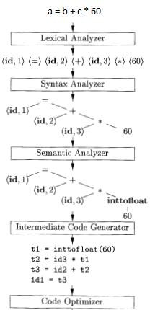
COMPILER DESIGN
The Structure of a Compiler (Phases of a Compiler)
t1 = id3 * 60.0 id1 = id2 + t1

Slide 9

COMPILER DESIGN
The Structure of a Compiler
(Phases of a Compiler)
LDF R2, id3
MULF R2, #60.0
LDF R1, id2 ADDF R1, R2 STF id1, R1
LD- Load
LD Register, Memory
ST- Store
ST Memory, Register
ADD- Additon ADD R1, R2 ADD R1, R2, R3
MUL - Multiplication
MUL R1, R2
For floating point numbers
LDF, STF, ADDF, MULF

Slide 10
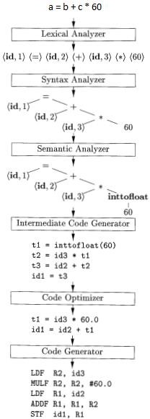

COMPILER DESIGN
The Structure of a Compiler
(Phases of a Compiler)

Slide 11
COMPILER DESIGN
The Structure of a Compiler
Symbol Table
Data structure containing a record for each variable name with fields for the attributes of the name
Attributes provides the information's about:
Storage allocation
Type
Scope (where in the program its value may be used)
Procedure names
Number and types of its arguments
Method of passing arguments (call by value or reference)

Slide 12
COMPILER DESIGN
Grouping of Phases into passes
Single pass Compiler – All phases are grouped into one part.
Two pass Compiler- The phases are grouped into two parts.

Slide 13
COMPILER DESIGN
Grouping of Phases into passes
Single pass Compiler –
Source program (HLL)
Two pass Compiler-
Analysis Part (Front end of Compiler)
Lexical Analysis Syntax Analysis Semantic Analysis
Intermediate Code Generator Code Optimization
Code Generator
Source program (HLL)
Lexical Analyzer
Syntax Analyzer
Semantic Analyzer
Intermediate code
Synthesis Part (Back end of
Compiler)
Code Optimizer
Code Generator
Target Machine code (Assembly language code)
Target Machine code
(Assembly level language)

Slide 14
COMPILER DESIGN: UNIT 1
The Role of Lexical Analyzer
Divyaprabha K N
Department of Computer Science & Engineering

Slide 15
COMPILER DESIGN
Detailed study of Lexical Analysis
The first phase of a compiler is called lexical analysis or scanning. The lexical analyzer reads the stream of characters making up the source program and groups the characters into meaningful sequences called lexemes. For each lexeme, the lexical analyzer produces as output a token of the form
(token-name, attribute-value)
that it passes on to the subsequent phase, syntax analysis. In the token, the first component token-name is an abstract symbol that is used during syntax analysis,
and the second component attribute-value points to an entry in the symbol table for this token.
Information from the symbol-table entry is needed for semantic analysis and code generation.

Slide 16
COMPILER DESIGN
Lexical Analysis Example
For example, suppose a source program contains the assignment statement
position = initial + rate * 60
The characters in this assignment could be grouped into the following lexemes and mapped into the following tokens passed on to the syntax analyzer:
position is a lexeme that would be mapped into a token (id, 1), where id is an abstract symbol standing for identifier and 1 points to the symboltable entry for position . The symbol-table entry for an identifier holds information about the identifier, such as its name and type.
The assignment symbol = is a lexeme that is mapped into the token (=). Since this token needs no attribute-value, we have omitted the second component. We could have used any abstract symbol such as assign for the token-name, but for notational convenience we have chosen to use the lexeme itself as the name of the abstract symbol.
initial is a lexeme that is mapped into the token (id, 2), where 2 points to the symbol-table entry for initial .
+ is a lexeme that is mapped into the token (+).
rate is a lexeme that is mapped into the token (id, 3), where 3 points to the symbol-table entry for rate .
* is a lexeme that is mapped into the token (*).
60 is a lexeme that is mapped into the token (60).

Slide 17
COMPILER DESIGN
Detailed study of Lexical Analysis
Final representation of the assignment statement after lexical analysis as the sequence of tokens
(id,l) (=) (id, 2) (+) (id, 3) (*) (60)
In this representation, the token names =, +, and * are abstract symbols for the assignment, addition, and multiplication operators, respectively.
Technically speaking, for the lexeme 60 we should make up a token like (number, 4), where 4 points to the symbol table for the internal representation of integer 60 but we shall defer the discussion of tokens for numbers until Chapter 2.
Chapter 3 discusses techniques for building lexical analyzers.

Slide 18
COMPILER DESIGN
Role of Lexical Analyzer
It reads the input characters of the source program , group them into Lexemes.
It produces a sequence of tokens for each lexemes in the source program as output.
The stream of tokens is sent to the parser for syntax analysis.
When it discovers the lexeme representing an identifier, it will enter that lexeme into the symbol table.

Slide 19
COMPILER DESIGN
Role of Lexical Analyzer
Other Tasks of Lexical Analyzer
Stripping out comments and white space like blank, new line, tab and other character that used to separate tokens in the input
Correlating error messages generated by the compiler with the source program.
It keep track of the number of the newline character and it associate each line number with each error message.
Expansion of macros.

Slide 20
COMPILER DESIGN
Role of Lexical Analyzer
Lexical Analyzer
Lexical Analyzer are divided into two process
Scanning :- this consists of the simple processes that do not require tokenization of the input, such as deletion of comments and compaction of consecutive whitespace character into one.
Lexical Analysis :- It produces the sequence of tokens as output.

Slide 21
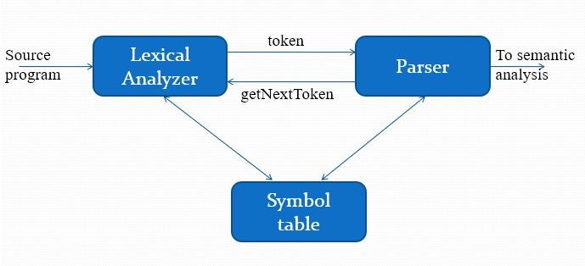
COMPILER DESIGN
Interaction Between the Lexical Analyzer and parser

Slide 22
COMPILER DESIGN
Role of Lexical Analyzer
Lexical Analyzer Versus Parsing
Reasons to separate lexical analyzer and syntax analysis into different phases of compiler
Simplicity of design. (Comments and spaces are removed in LA)
Compiler efficiency is improved. (LA use specialized techniques for lexical task, but not the job for parsing. Buffering tech. is used for reading chars can speed up compiler)
Compiler portability is enhanced.

Slide 23
COMPILER DESIGN
Role of Lexical Analyzer
Tokens, Patterns and Lexemes Related but distinct terms :
Token :- It is a pair consisting of a token name and an optional attribute value.
< token name, attribute value>
Token name is an abstract symbol representing a kind of lexical unit like keywords, identifiers
Attribute value is pointer to the symbol table entry

Slide 24
COMPILER DESIGN
Role of Lexical Analyzer
Tokens, Patterns and Lexemes
Pattern :- is a description of the form that the Lexemes of a token may take.
keyword- sequence of character
Identifiers - sequence of character with some complex Structure
Lexeme :- It is a sequence of characters in the source program that matches the pattern for a token as an instance of a token

Slide 25
COMPILER DESIGN
Role of Lexical Analyzer
Examples of Tokens
Token | Informal Description(pattern) | Sample Lexemes
(keyword) | Character i,f | If
(keyword) | Characters e,l,s,e | else
Comparison | < or > or <= or >= or == or != | <=,!=
id | Letter followed by letters and digits | Sum, avg1, pi
number | Any numeric constant | 10001, 3.14
literal | Anything but “, surrounded by “’s | “ compiler design”
printf(“total = %d\n”, score);

Slide 26
COMPILER DESIGN
Role of Lexical Analyzer
Example: Find the number of tokens
1. int a = 20;
Lexeme |  | Tokens | Count of Token

Slide 27

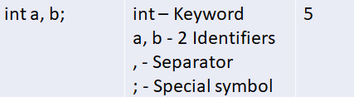
COMPILER DESIGN
Role of Lexical Analyzer
Example: Find the number of tokens
lexeme |  | Tokens | Count of Token
2. Find number of tokens in the given code. int main()
{
//Compiler Design int a, b;
a = 10;
b = 20;
return 0;
}

Slide 28
COMPILER DESIGN
Role of Lexical Analyzer
Attributes for Tokens
When more than one lexeme can match a pattern, lexical analyzer must provide additional information about the lexeme
Lexical analyzer returns token name and attribute value to parser.
Consider the example : token
id
Its attributes are , its lexeme, its type and the location at which it is first found is kept in the symbol table.
Attribute value is pointer to the symbol table entry for that identifier.

Slide 29
Role of Lexical Analyzer
COMPILER DESIGN
Example: Write the token names and associated attribute
values for the given statement:
E = M * C ** 2
<id, Pointer to symbol table entry for E >
<assign_op>
<id , Pointer to symbol table entry for M>
<mult-op>
<id, Pointer to symbol table entry for C>
<exp-op>
<number, integer value 2>

Slide 30
COMPILER DESIGN
Role of Lexical Analyzer
Lexical Errors
Suppose a situation arises in which the lexical analyzer is unable to proceed because none of the pattern for tokens matches any prefix of the remaining input.
Spelling Error –
di {….
…………………..} while();
fi
fi (a == f(x))
Spelling Error
Spelling
Error
Unmatched string
Appearance of illegal characters
Exceeding length of identifiers

Slide 31
COMPILER DESIGN
Role of Lexical Analyzer
Lexical Errors
Suppose a situation arises in which the lexical analyzer is unable to proceed because none of the pattern for tokens matches any prefix of the remaining input.
Unmatched String-
printf(“hi);
fi
fi (a == f(x))
printf(“hi”);
Spelling Error
Unmatched string
Appearance of illegal characters
Exceeding length of identifiers

Slide 32
COMPILER DESIGN
Role of Lexical Analyzer
Lexical Errors
Suppose a situation arises in which the lexical analyzer is unable to proceed because none of the
Appearance of Illegal character
pattern for tokens matches any prefix remaining input.
of the printf(“hi”)$$;
fi
fi (a == f(x))
Spelling Error
Unmatched string
Appearance of illegal characters
Exceeding length of identifiers

Slide 33
COMPILER DESIGN
Role of Lexical Analyzer
Lexical Errors
Suppose a situation arises in which the lexical analyzer is unable to proceed because none of the pattern for tokens matches any prefix of the remaining input.
Exceeding length of identifier
More than 32 characters in identifier
fi
fi (a == f(x))
Spelling Error
Unmatched string
Appearance of illegal characters
Exceeding length of identifiers

Slide 34
COMPILER DESIGN
Role of Lexical Analyzer
Error Recovery Actions
Delete one character from the remaining input.
Insert missing character into the remaining input
Replace character by another character
Transpose two adjacent characters.
Delete successive characters from the remaining input until Lexical Analyzer recognizes a well-formed token. This is also called PANIC MODE error recovery.

Slide 35
COMPILER DESIGN
Role of Lexical Analyzer
Error Recovery Actions
Delete one character from the remaining input.
Insert missing character into the remaining input
Replace character by another character
Transpose two adjacent characters.
Example - dio{…
…..
} while();
Delete successive characters from the remaining input until Lexical Analyzer recognizes a well-formed token. This is also called PANIC MODE error recovery.

Slide 36
COMPILER DESIGN
Role of Lexical Analyzer
Error Recovery Actions
Delete one character from the remaining input.
Example - prntf(“hi”);
Insert missing character into the remaining input
Replace character by another character
Transpose two adjacent characters.
printf(“hi”);
Delete successive characters from the remaining input until Lexical Analyzer recognizes a well-formed token. This is also called PANIC MODE error recovery.

Slide 37
COMPILER DESIGN
Role of Lexical Analyzer
Error Recovery Actions
Delete one character from the remaining input.
Insert missing character into the remaining input
Example - di{…
…..
} while();
Replace character by another character
Transpose two adjacent characters.
Delete successive characters from the remaining input until Lexical Analyzer recognizes a well-formed token. This is also called PANIC MODE error recovery.

Slide 38
COMPILER DESIGN
Role of Lexical Analyzer
Error Recovery Actions
Delete one character from the remaining input.
Insert missing character into the remaining input
Replace character by another character
Example - rpintf(“hi”);
printf(“hi”);
Transpose two adjacent characters.
Delete successive characters from the remaining input until Lexical Analyzer recognizes a well-formed token. This is also called PANIC MODE error recovery.

Slide 39
COMPILER DESIGN
Role of Lexical Analyzer
Error Recovery Actions
Delete one character from the remaining input.
Insert missing character into the remaining input
Replace character by another character
Transpose two adjacent characters.
Example - printf(“hi”)$$;
printf(“hi”);
Delete successive characters from the remaining input until Lexical Analyzer recognizes a well-formed token. This is also called PANIC MODE error recovery.

Slide 40

Compiler Design Error Message
When writing an error message, make sure it satisfies the following properties:
It must pinpoint the error correctly
It must be understandable
It must be specific
It must not have any redundancy

Slide 41
THANK YOU
Divyaprabha K N
Department of Computer Science & Engineering
divyaprabha@pes.edu

